Slide 1
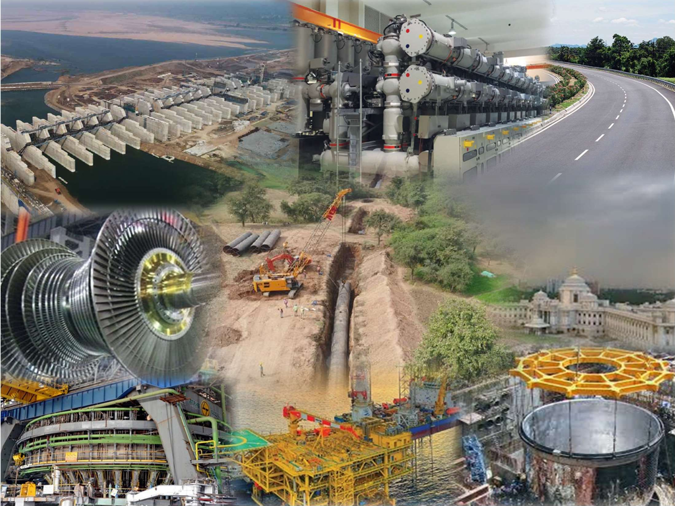

LARSEN & TOUBRO
Induction Module
Notes:
BS

Slide 2
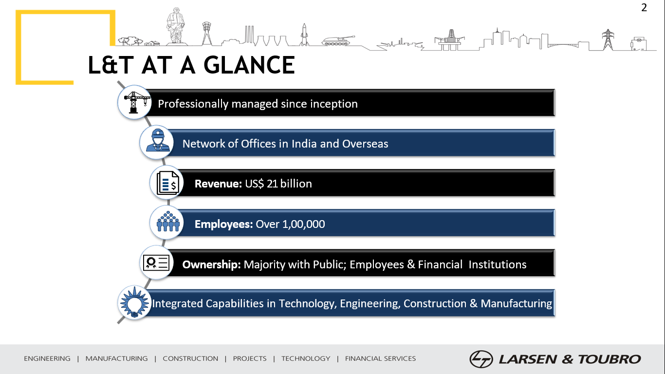
Professionally Managed Since Inception
2

Slide 3

L&T Founders

Slide 4
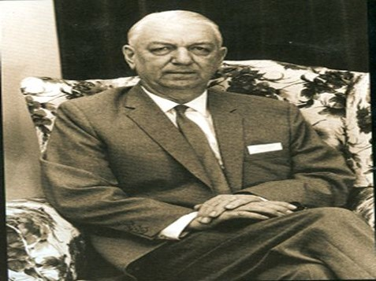
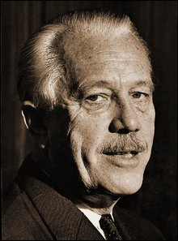
SOREN KRISTIAN TOUBRO
(27th February 1906 - 4th March 1982) Co-founder
HENNING HOLCK-LARSEN (4th Aug 1907 – 27th Jul 2003) Co-founder
He was a Civil Engineer from Denmark. He came to India in 1934 for the construction work for a Cement factory.
After entering India, he read a statement by Gandhiji saying:
"(I am) not leading a movement to rid India of its white colonial masters in order to substitute them with brown ones."
Toubro felt that such an India would "offer great opportunities to anyone with modern technological and management skills".
Soon enough, he cofounded L&T. He was the Director of L&T from 1946 to 1981.
In the year 1964, at the age of 58 years, he relinquished his executive responsibility and retired from L&T Management Pvt. Ltd.
However, he continued to serve on the Board of Directors of L&T till 1981
A Chemical Engineer from Denmark, he came to India in the year of 1935 to assess the value of various cement manufacturing groups. Cofounded L&T in 1938, he served as the Chairman of the company up to 1978 –up to the age of 71. Post that, Chairman Emeritus of L&T till death.
Recognition by the Indian Government:
2002 : Padma Bhushan Award – India’s Second highest Civilian Award
2001: Bombay Management Association’s Lifetime Achievement Award
1976 : Awarded ‘Raman Magsaysay Award’ for International Understanding

Slide 5
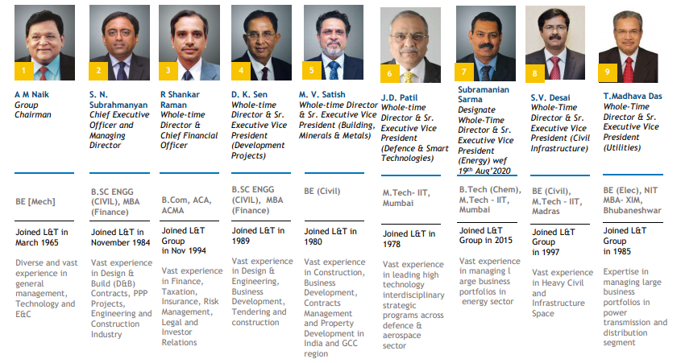
Management Team
5

Slide 6










Segment Composition
Infrastructure
Power
Heavy Engineering
Defence
Engineering
Hydrocarbon
Buildings & Factories (B&F)
Transportation Infra (TI)
Heavy Civil infra (HC)
Water & Effluent Treatment (WET)
Power T&D (PT&D)
Metall. & Mat. Handling (MMH)
EPC- Coal & Gas
Thermal Power Plant Construction
Electrostatic Precipitator
Power Equipment Mfg.
Process Plant Equipment
Nuclear Power Plant Equipment
Piping Centre & Forgings
Defence
Aerospace
Shipbuilding
Onshore
Offshore
IT & TS
Financial
Services
Developmental Projects
New Initiatives
Others
Information Technology
(LTI & Mindtree)
Technology Services
Rural Lending
Housing Finance
Wholesale Finance
Asset Management
Roads / Trans. Line
Metros
Power
L&T NxT
SuFin
Edutech
L&T Innovation Fund
Realty
Industrial Products & Machinery
Smart World & Comm.(SW&C)
6

Slide 7
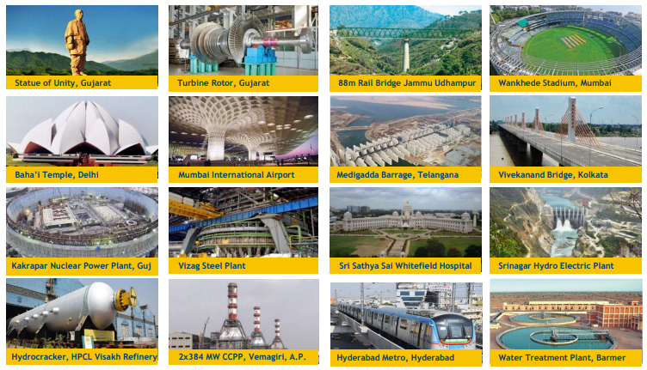
Builders of the Nation
7

Slide 8
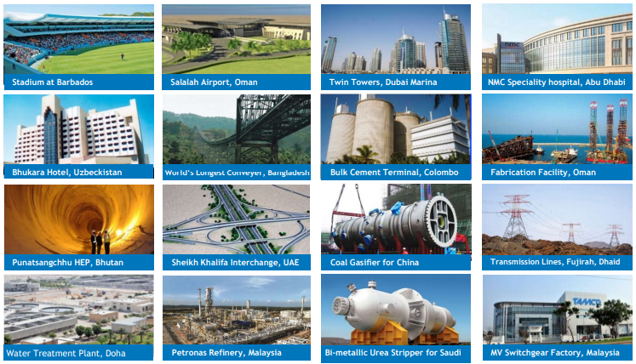
International Footprint – Marque Projects
8

Slide 9
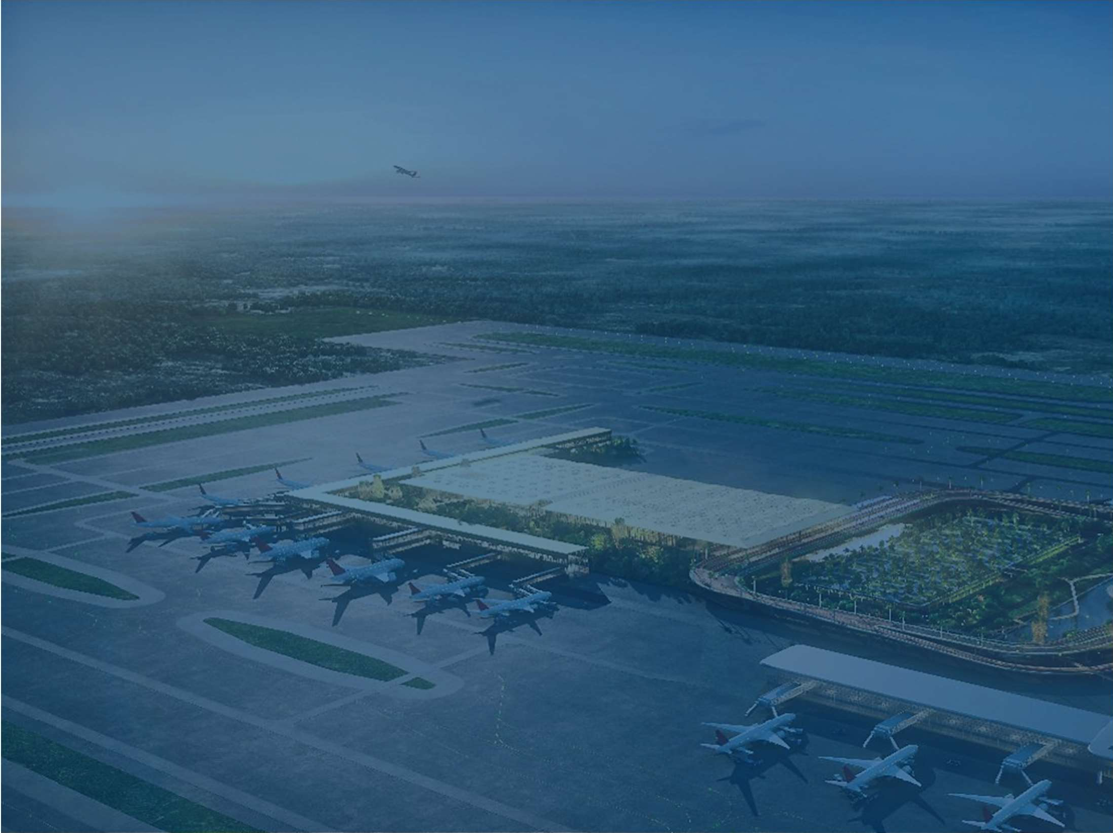

Corporate Governance
L&T’s essential character revolves around values based on transparency, integrity, professionalism and accountability.
Board
of Directors
Four-tier Governance Structure
Executive Committee (ECom)
Independent Company (IC) Board
Strategic Business Group (SBG) / Business Unit (BU)
9

Slide 10



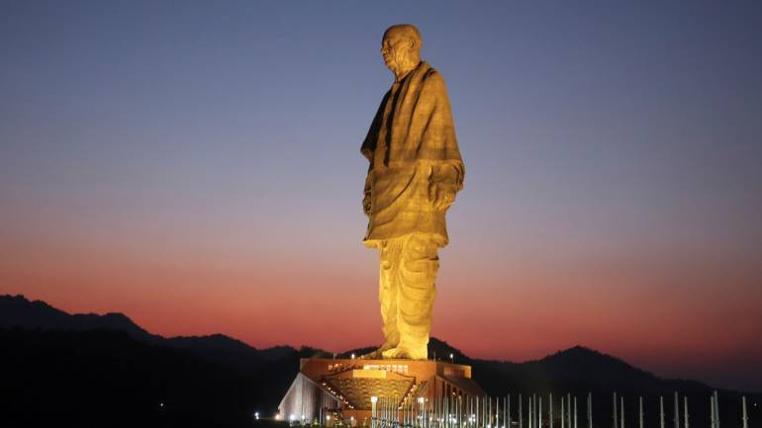







Awards and Rankings
Golden Peacock Award for Risk Management Corporate Governance
L&T-built Statue of Unity features in World Architecture News Awards 2019
D&B Awards : Winner – Construction
& Infrastructure
Consistently Ranked among Top 10 valued brands in India
WORLD’S BEST EMPLOYERS
‘Special Recognition Award’ in the 2018 Employer Brand Research Survey
L&T highest-ranked
Indian firm and the only one to feature in the top 50
L&T built airports fly
high in global rankings
Quality Systems Excellence Awards – First Prize
10

Slide 11
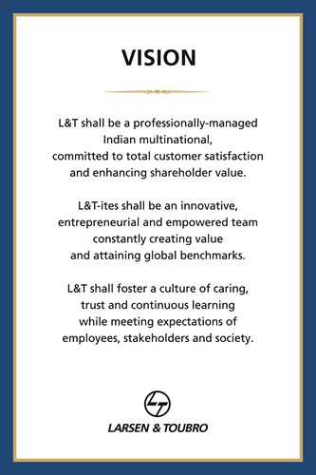
L&T Vision Statement
Customer
Satisfaction
Professional
Innovative
Empowered
Trust
Caring
Meet Society’s
Expectations
Continuous
Learning
11

Slide 12
INTRODUCTION
12

Slide 13










Players in a B2B marketplace
Financing
IT/Technology systems
Contract/ Legal support
Government
Government
Payments
Large corp.
Large corp.
Mid corp.
Buyer
Seller
Mid corp.
SMEs
SMEs
Goods & Services
Micro
Micro
SECONDARY
Manufacturing /
Operations
Labour contractors
Logistics
PRIMARY
SOURCE: McKinsey
13
Notes:
BP

Slide 14
ADDRESSING PAIN-POINTS OF MSMEs
MSMEs in India suffer due to the inefficiencies in the Supply Chain system
Key Challenges faced by MSME in Scaling their Business
Lack of channel to get Wider Market Access
Getting access to large buyers with level playing field (Discovery)
Lack of TRUST between operators & participants for executing Transactions
Getting credit from formal financial system
Lack of RELIABLE LOGISTICS services
Leveraging Digitization & Ecommerce
Establish digital as well as physical distribution across the country
Reach out to Mid & Large Size companies & provide access to the MSMEs
Create trust through verifications, certifications & experience
Ensuring working capital and term loans through Banking & NBFC partnerships
Enabling Logistics solutions as required
14

Slide 15
L&T SUFIN BUSINESS MODEL
15

Slide 16
L&T SUFIN – INTEGRATED SOLUTION
Product DISCOVERY
01
02
Product TRANSACTION
Buyers can find the Right products and services at optimal cost and quality
Suite of Services like Direct purchase, Request of Quotations (RFQ), with options of credit period
PURE-PLAY MARKETPLACE for the Industrial, Construction and Engineering Goods, where:
- Vendor Diversity is ensured
- Vendor Quality and Trust is ensured
- Stickiness is ensured through Working Capital
Solution and Order fulfilment through
Logistics services.
04
03
Product FINANCE
Product LOGISTICS
Solutions to meet the Working Capital Requirements
Provides wider reach to the Seller to cater to geographic spread
16

Slide 17
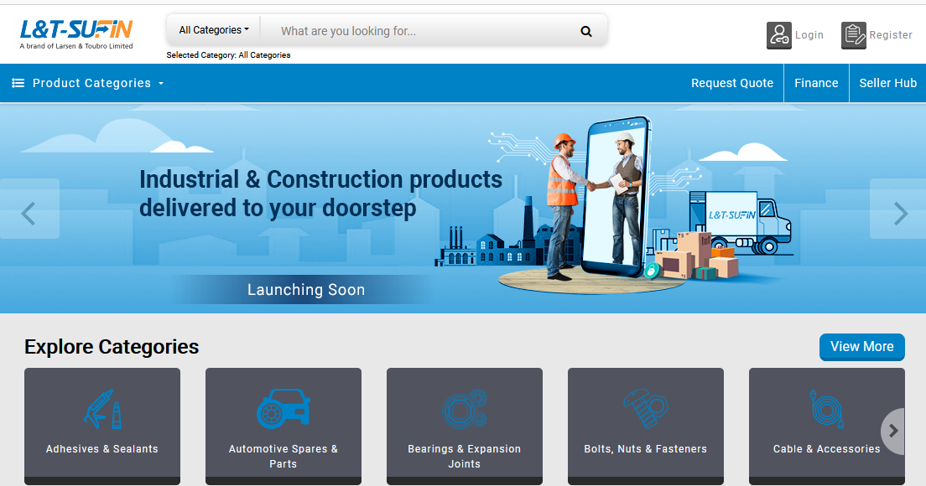
L&T SuFin Marketplace
SEARCH
Industry benchmarked for Right Product Search
NOTIFICATIONS
Easy Order Tracking, Messages & Alerts
REGISTER / LOGIN
Seamless Login / Register process
PRODUCT CATEGORIES
3 Level Product Search L&T Taxonomy Strength
PROFILE MANAGE
Multi-level Profile Management
BANNER ADS
Capturing Value-proposition
SELLER HUB
Seamless Toggle b/w Buyer and Seller
EXPLORE CATEGORIES
Caters to 40+ Product Categories at launch and expand to other product categories within 1 Year of launch
LOGISTICS TAB
Leveraging marketplace logistics services
POPULAR DEALS
Nudging the vendors for cross-selling
SIDE BANNER
Value Added Service
17

Slide 18
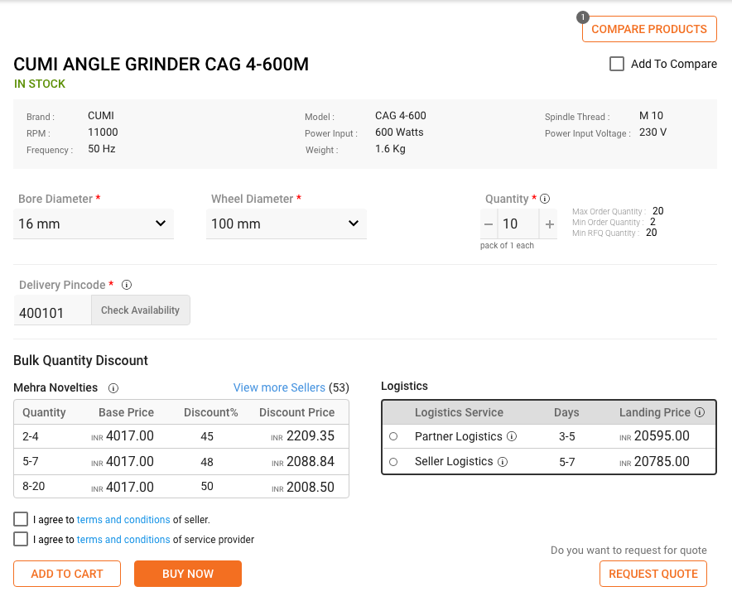

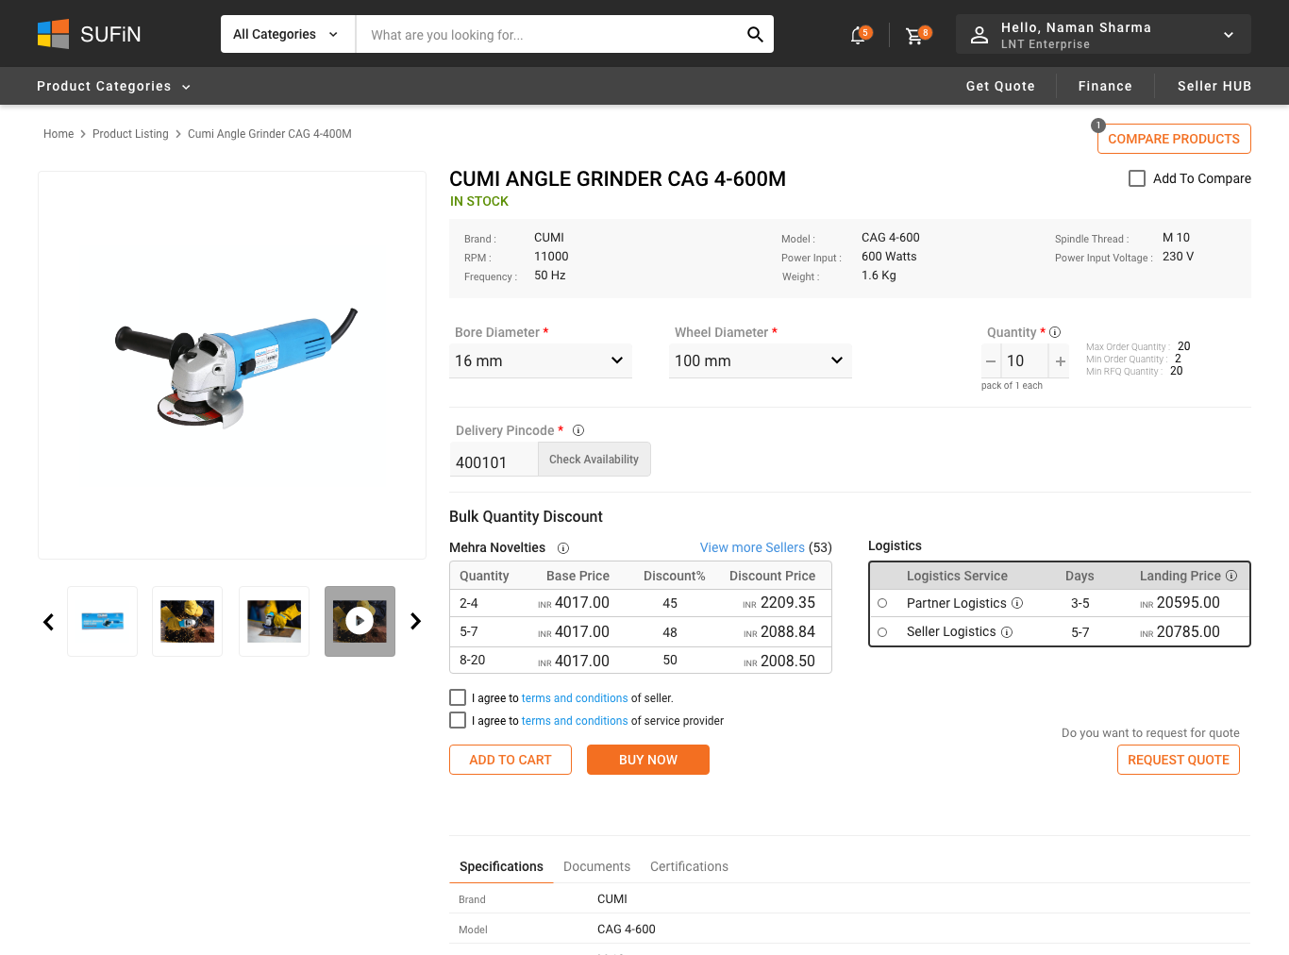
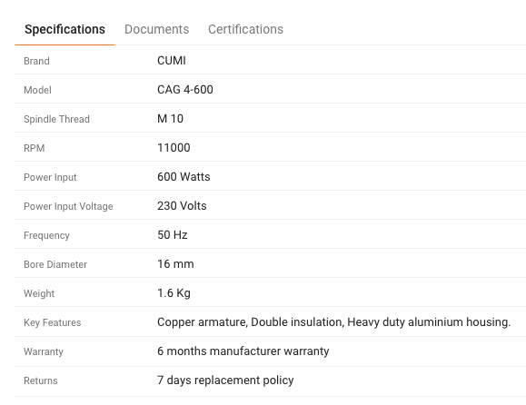
Product Attributes ~20 Attributes
L&T SuFin Marketplace
Product Specifications
18

Slide 19
Over 40+ Product Categories on SUFIN
Machinery, Tools & Mechanical Equipment
Industrial Supplies and Consumables
Building and Construction Materials
Automotive Spares & Parts
Bearings & Expansion Joints
Bolts, Nuts & Fasteners
Industrial Cleaning Chemicals
Lubricants & Oils
Safety Material
Welding Consumables
Construction Machinery
Cranes & Hoists
Hydraulics
Lab Equipment & Supplies
Material Handling Equipment
Measuring and Testing Instruments
Mechanical Equipment
Pneumatics & Pumps
Power Tools
Textile Machinery
Tools & Accessories
Adhesives & Sealants
Granite, Marble & Tiles
Masonry Blocks & Bricks
Paints & Related Material
Pipes & Fittings
Plumbing Tools & Accessories
Reinforcement Steel (MS & GI wires)
Sanitary Ware & CP Fittings
Structural Steel
Wood & Laminates
Electrical & Electronic Equipment & Supplies
Cable & Accessories
Conductors
Electrical Equipment & Supplies
Electronics, IT & Robotics
Insulators & Hardware Fittings
Luminaires & Other Electrical Items
Solar Equipment & Panels
Switchgear, Relay & Contactor
Packaging, Printing and Office supplies
Office Supplies
Packaging Material
19

Slide 20
VALUE PROPOSITION
20

Slide 21





How SuFin will create value for Users @ Launch
Request for Quotation (RFQ)
This is a discovery feature for better price realization and dealing with unknown suppliers through the platform’s digital Assistance. RFQ option in SuFin is unique feature and No other peer platform has this feature of multi product RFQ on both credit & immediate payment terms.
Working Capital Solution
Unsecured Financing enabled through a gamut of products like Overdraft, Invoice discounting, Equipment Financing, Channel Financing by multiple Lenders. Other platforms fund at a higher rate of interest through own NBFCs and only business loan or bill discounting available.
Distributor Financing & Digital Channels for Mid-Corporate entities at a Minimal Cost.
Distributor financing is not available with any other platforms
Verification and Trust Seals to give confidence for dealing with unknown entities.
BUYERS to know the Qualitative aspects of the SELLERS
SELLERS to know the Credit worthiness of the BUYER
Provided only by India Mart and JD Mart which are discovery-based platforms
Logistics and Payment Gateway Services for order fulfilment and convenience

Slide 22
CUSTOMER SEGMENTATION
22

Slide 23
BUYER-SIDE SEGMENTATION
SELLER-SIDE SEGMENTATION
MANUFACTURERS:
Small and Medium Enterprises as per GoI definition, and Mid-Corporates excluding Micro entities with very small setup
SME – OEMs, TRADERS & RESELLERS:
Small and Medium Enterprises who are into the Manufacturing & Selling of Industrial and construction products
BUILDING CONTRACTORS (Residential & Commercial):
Small Contractors: Building houses for owners and G+2 / G+3 apartment projects and Involved in minimum 3 projects in a year with a turnover of INR 1-20 Cr
Mid –Contractors: Involved in minimum 15 projects in a year with a turnover of INR 20 Cr+.
LARGE OEM & DISTRIBUTORS:
Offer products at competitive prices
Category management team to target and onboard Sellers by negotiating with OEMs and Large Distributors
TRADERS & RESELLERS:
Suppliers offering products at Market prices
INFRASTRUCTURE CONTRACTOR:
Contractors operating in Infrastructure Sectors of Roads, Railways, Factory and Power Infrastructure
CORPORATES:
Entities with a turnover of more than Rs 1000 Cr
L&T Business Verticals and ICs
IMMEDIATE
GoI Definition (OLD): Investment in plant & machinery:- Micro <Rs 25 L ; Small; Rs 25L to 5 Cr; Medium: Rs 5 Cr to 10 Cr
23
Notes:
OEM – Original Equipment Manufacturer

Slide 24
INDUSTRY CLUSTERS
24

Slide 25
Industrial Coverage …Page 1/3
STATE | CITY / REGION
Gujarat | Ahmedabad, Amreli, Anand, Ankleshwar, Bamanbor, Banaskantha, Bardoli, Bharuch, Bhavnagar, Bilimora, Bodeli, Botad, Chhatral, Dadra, Deesa, Dhrol, Vadodara, Gandhi Nagar, Halol, Godhra, Junagarh, Gandhidham, Kalol, Karamsad, Karvad, Khambalia, Mahuva, Mehsana, Mundra, Padavala, Nadiad, Patan, Rajkot, Santej, Shapar, Sihor, Surat, Tapi, Thaltej, Umargaon, Valsad, Vapi, Veraval, Vitthal Udyognagar
Tamil Nadu | Ambatur, Arcot, Ariyalur, Arupukottai, Chengalpattu, Chennai, Coimbatore, Cuddalore, Dhindigul, Erode, Kallakurichi, Kanchipuram, Karur, Kilakarai, Kotturpuram, Nagarcoil, Namakkal, Nilgiris, Perambadur, Salem, Singanallur, Tambaram, Tanjavaur, Thoothukudi, Tirunelvali, Tirupur, Trichy, Tuticorin, Virudhunagar, Vellore, Villupuram, Pondicherry
Maharashtra & Goa | Mapusa, Margoa, Ponda, South Goa, Ahmednagar, Akola, Ambarnath, Amravati, Aurangabad, Badlapur, Baramati, Beed, Bhiwandi, Boisar, Chandrapur, Chalisgaon, Dhule, Gondia, Jalgaon, Kalyan, Khargar, Latur, Nasik, Nagpur, Palghar, Pune, Raigarh, Sindhudurg, Thane, Vasai, Virar
New Delhi | Badarpur, Bawana, Central, North, East Delhi, Samalkha, Samaypur, Tilak Nagar, Uttam Nagar, Saiduljab

Slide 26
Industrial Coverage …Page 2/3
STATE | CITY / REGION
Uttar Pradesh | Agra, Aligarh, Allahabad, Amethi, Bhagpat, Bijnour, Bulandshahar, Chandrauli, Deoria, Firozabad, Gautam Buddh Nagar, Ghaziabad, Gorakhpur, Hamirpur, Kanpur, Khurja, Lucknow, Mathura, Meerut, Mirzapur, Moradabad, Muzzafarnagar, Noida, Sahibabad, Sultanpur, Varanasi, Sikandarabad
West Bengal | Asansol, Bankura, Barasat, Bardhaman, Barrackpur, Birbhum, Bolpur, Burdwan, Cooch Behar, Durgapur, Haldia, Hooglay, Jalpaiguri, Howrah, Kaliganj, Kharagpur, Kaliganj, Kolkata, Madhyamgarh, Raigang, Rajpur, Sonajpur, Sonarpur, Tribeni
Haryana | Bahadurgarh, Bawal, Faridabad, Gurugram, Karnal, Jind, Palwal, Panipat, Rai, Rewari, Hisar, Rohtak, Sirsa, Sonipat, Yamuna Nagar
Karnataka | Bengaluru, Belgaum, Ballery, Dharwad, Gulbarga, Hospet, Hubli, Karwar, Kolar, Mysore, Tumkur, Mangalore, Udupi, Vijayapur
Rajasthan | Alwar, Balotra, Bhiwadi, Bikaner, Dholpur, Jaipur, Jhunjuna, Kishangarh, Rajasthan, Udaipur, Jodhpur

Slide 27
Industrial Coverage …Page 3/3
STATE | CITY / REGION
Madhya Pradesh | Bhopal, Chindwara, Dewas, Gwalior, Hoshangabad, Khargone, Neemuch, Ratlam
Punjab | Firozpur, Gurdaspur, Jalandhar, Ludhiana, Moga, Mohali, Zirakpur, Amritsar
Telangana | Fatehnagar, Hyderabad, Medak, Medchal, Nalagonda, Sangareddy, Secunderabad
Odisha | Angul, Bhubaneshwar, Cuttack, Jharsuguda, Khurda, Rourkela, Sambalpur, Sundargarh
Kerala | Angamaly, Ernakulam, Kottayam, Mallapuram, Palakkad
Bihar | Darbhanga, Madhepur, Newada, Patna, Purnia, Rohtas
Jharkhand | Chirkunda, Dhanbad, Jamshedpur, Durg, Ranchi
OTHERS | Guntur, Nellore, Rajahmundry, Vizag, Vizianagram, Bhilai, Raipur, Silvasa, Dadra & Nagar, Baddi, Sirmaur, Solan, Guwahati, Tinsukia, Daman, Manipur & Nagaland, Arunachal Pradesh, Chandigarh

Slide 28
Competitor Comparison & Value Proposition @ LAUNCH
28

Slide 29











COMPARISON – Competition v/s L&T SuFin …1/2
Parameter of comparison
Target Customers | Corporates | Small Manufacturers | Real Estate, Construction & Government Companies | General Consumers | SME Manufacturers, Building & Infra. Contractors and Large Corporates
Business Model | Demand Aggregation | Commodity supplier to SMEs on credit | Solutioning for Contracted Customers | Discovery Only, Lead generation | Integrated Market Place
Product Scope | MRO, Consumables | Raw Material, Commodities | Construction Material | All B2B, B2R and B2C products | MRO & Consumables
Price Discovery | Rate contracts with Corporates | Pricing negotiations with MSMEs with contracts | Rate Contracts, manual intervention depending on customer | No price discovery. Only lead generation | Request for Quotes & Credit terms OR Purchase on Cash, Rate Contracts facilitated in RFQs
Enabling Payment | Yes | Yes | Yes | No transactions facilitated | Yes

Slide 30


COMPARISON – Competition v/s L&T SuFin …2/2
Parameter of comparison
Financing | Selected cases for Invoice Discounting on own books | Own NBFC | Provides goods on credit terms. No financing | No financing directly or through partners | Working capital overdrafts, invoice discounting, supply chain finance and loans through partner banks
Logistics | Local Milk Runs. No long hauls, hyperlocal model. Owned logistics model | Supplier logistics | Available through partners | No logistical support | All requirements through partners
Credit Period | Provided only to chosen Corporates | Provided to MSMEs | Provided to all customers | No transactions. Hence no credit period | Yes depending upon terms of Purchase Order
Trust Creation | Own Inventory & responsible for quality with complete buy back. Back to back arrangement with suppliers | Own Inventory & responsible for quality with complete buy back. Back to back arrangement with select SME suppliers | Own Inventory, private labels and assurance of quality by the platform | Trust and Verification seal based on association and subscription amounts | Trust and Verification seal through online verifications by fintech partners & field visits by risk containment agencies. Behavioural scores.

Slide 31

Organization Structure
31

Slide 32
Organization Structure for Launch
HIRED
Joined
HIRED
Yet to Join
PENDING FOR RECRUITMENT
Business Head
(Bhadresh Pathak)
Chief information services officer
Shared services
HR
(Manjit Bakshi)
Finance
(Chirag Shah)
Legal
(Amarnath G)
Chief Commercial officer
(Abhilash Pillai)
Chief Category Officer
(Ashish Kaistha)
Chief Operating officer
(Bikramjit Sen)
Head of partnerships & Strategy
Chief Product Officer
(Rupesh Goel)
Chief Technology Officer
(Indranil Mitra)
GTM & Business Dev.
Marketing & analytics
N Seetharaman
Strategic seller
Ops. & customer ser.
(Lalit Khurana)
Logistics
(Surajit Goswami)
Lending ops
(Kartik Iyer)
Partnership managers
Design head
Product imple-mentation & integration
System architecture
Sales (buyer acquisition)
Offline marketing
Dr Prasantha Dash
Onboarding
Logistics Partner mgt.
Lending Partner Processes
Program manager (Onboarding, Catalogue, RFQ, Search)
Project mgmt, system analysis & design
New product development
Sales team(including national leads, state leads, RM, etc.)
Sunil Rana
Catalogue Mgmt.
Buyer and Seller coordination
Disputes/ Collection /Legal Remedies
Dev/QA
Online marketing
Payment Processing
Warehousing Solutions
Program Manager (Logistics, Order mgmt, Finance)
IT infra & app support
PR & comms.
Purwang Shah
Enterprise/ corporate buyers
Credit risk mgmt.
Recon. & Settlement
IT security - DBA
Data & behavioral analytics
Category mgr.
Returns mgt.
RMs and solutions team
Digital journeys
Customer Service
Program Mgr- Integration (Financiers, Fintech Partners, Corporates)
VRM
In-house design team
Tele calling team
Quality
ERP integration
32

Slide 33

Welcome to the
L&T Family

